Slide 1


HOKIE BRAND CAMP
Licensing and Trademarks Updates

Slide 2
Quote Callout
LICENSING AND TRADEMARKS UPDATES
Protecting and Strengthening the Virginia Tech Brand
All internal uses of VT trademarks must align with brand standards (logos, colors, fonts, graphic style).
Ensures that every product — from a student org t-shirt to a department mug — reflects one unified Hokie identity.

Slide 3
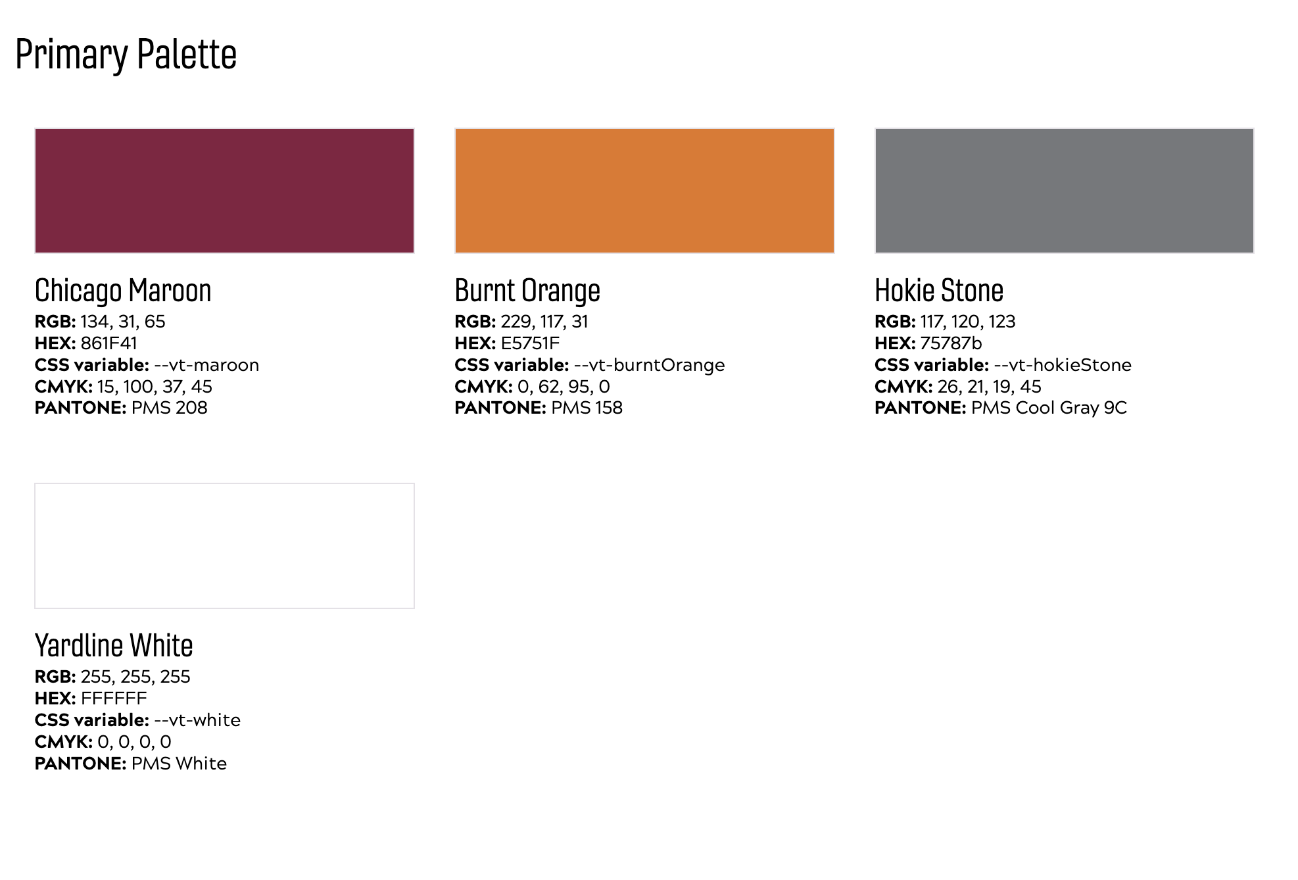
Quote Callout
LICENSING AND TRADEMARKS UPDATES
Virginia Tech colors and PMS

Slide 4
Quote Callout
LICENSING AND TRADEMARKS UPDATES
Questions or Comments

