Slide 1


HOKIE BRAND CAMP
Media Matters: Collaborating with Faculty to Elevate Stories
Michael Stowe, Senior Director and Executive Editor of Communications and Marketing
Margaret Ashburn, Associate Director of Media Relations

Slide 2
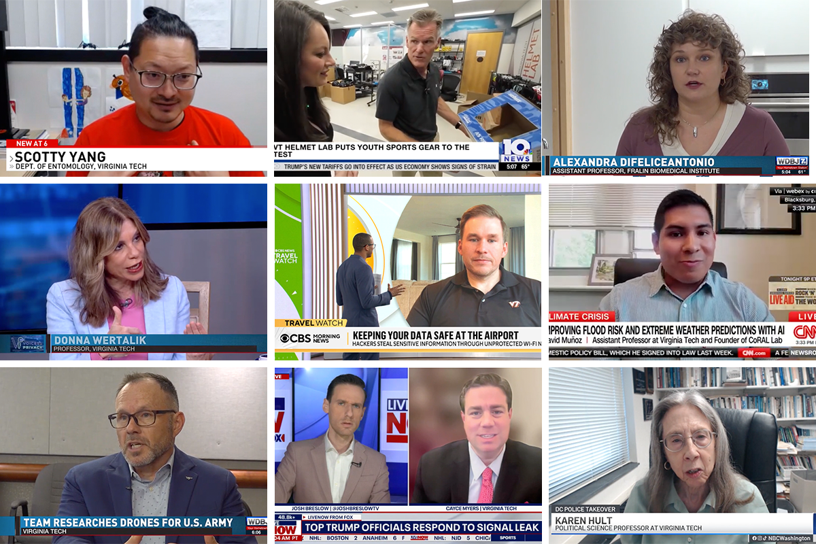
Quote Callout
MEDIA MATTERS
Today’s Goals
Build stronger partnerships
Gain faculty insights
Share case studies
Have a conversation
Learn from each other

Slide 3

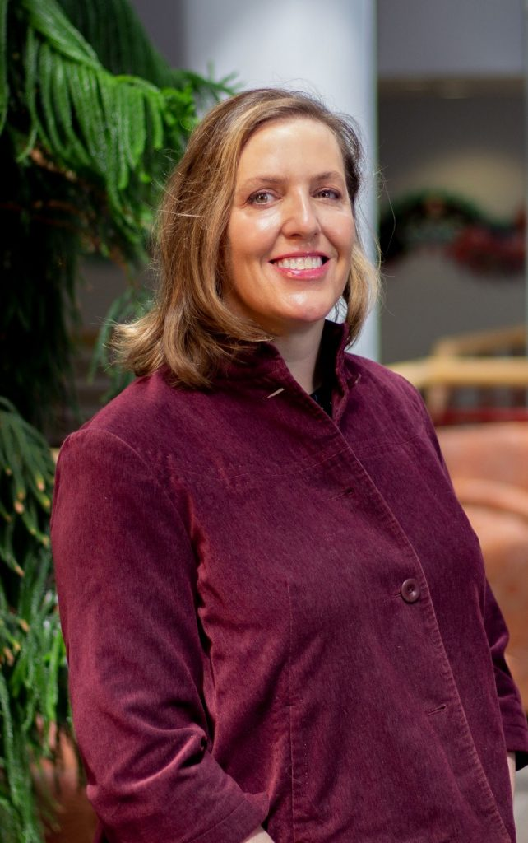
Quote Callout
MEDIA MATTERS
Meet our guests
Jadrian Wooten
Collegiate Associate Professor, Department of Economics
College of Science
Erica Feuerbacher
Associate Professor, School of Animal Sciences
College of Agriculture and Life Sciences

Slide 4
Case Study:
Acting as a faculty expert
Notes:
Makes economics relatable through culture, consumer choices, and current events
Engages with media by providing timely, clear insights

Slide 5
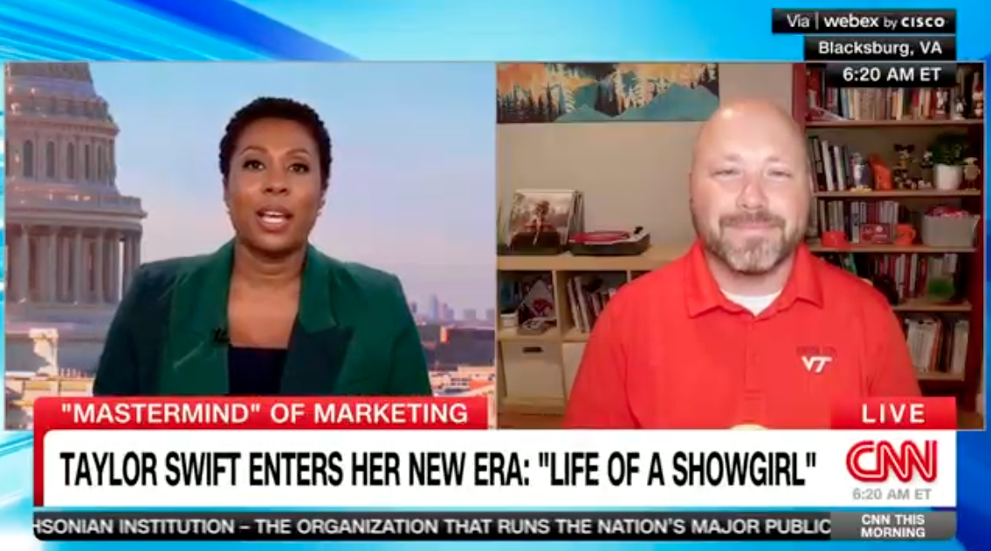
Notes:
\

Slide 6
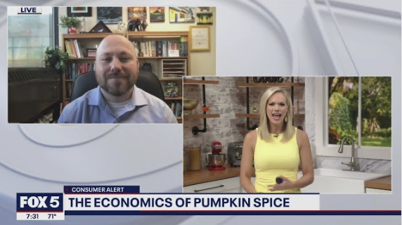
Notes:
\

Slide 7
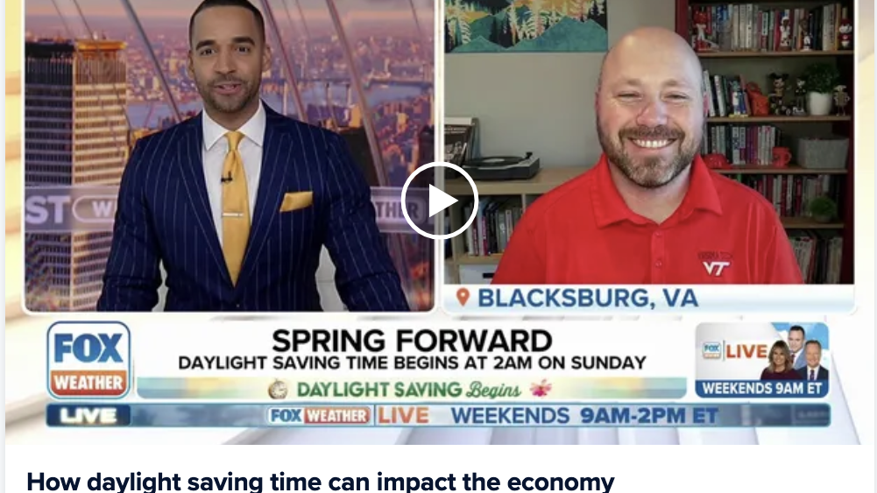
Notes:
\

Slide 8
Case Study:
Elevating Faculty Research
Notes:
\

Slide 9
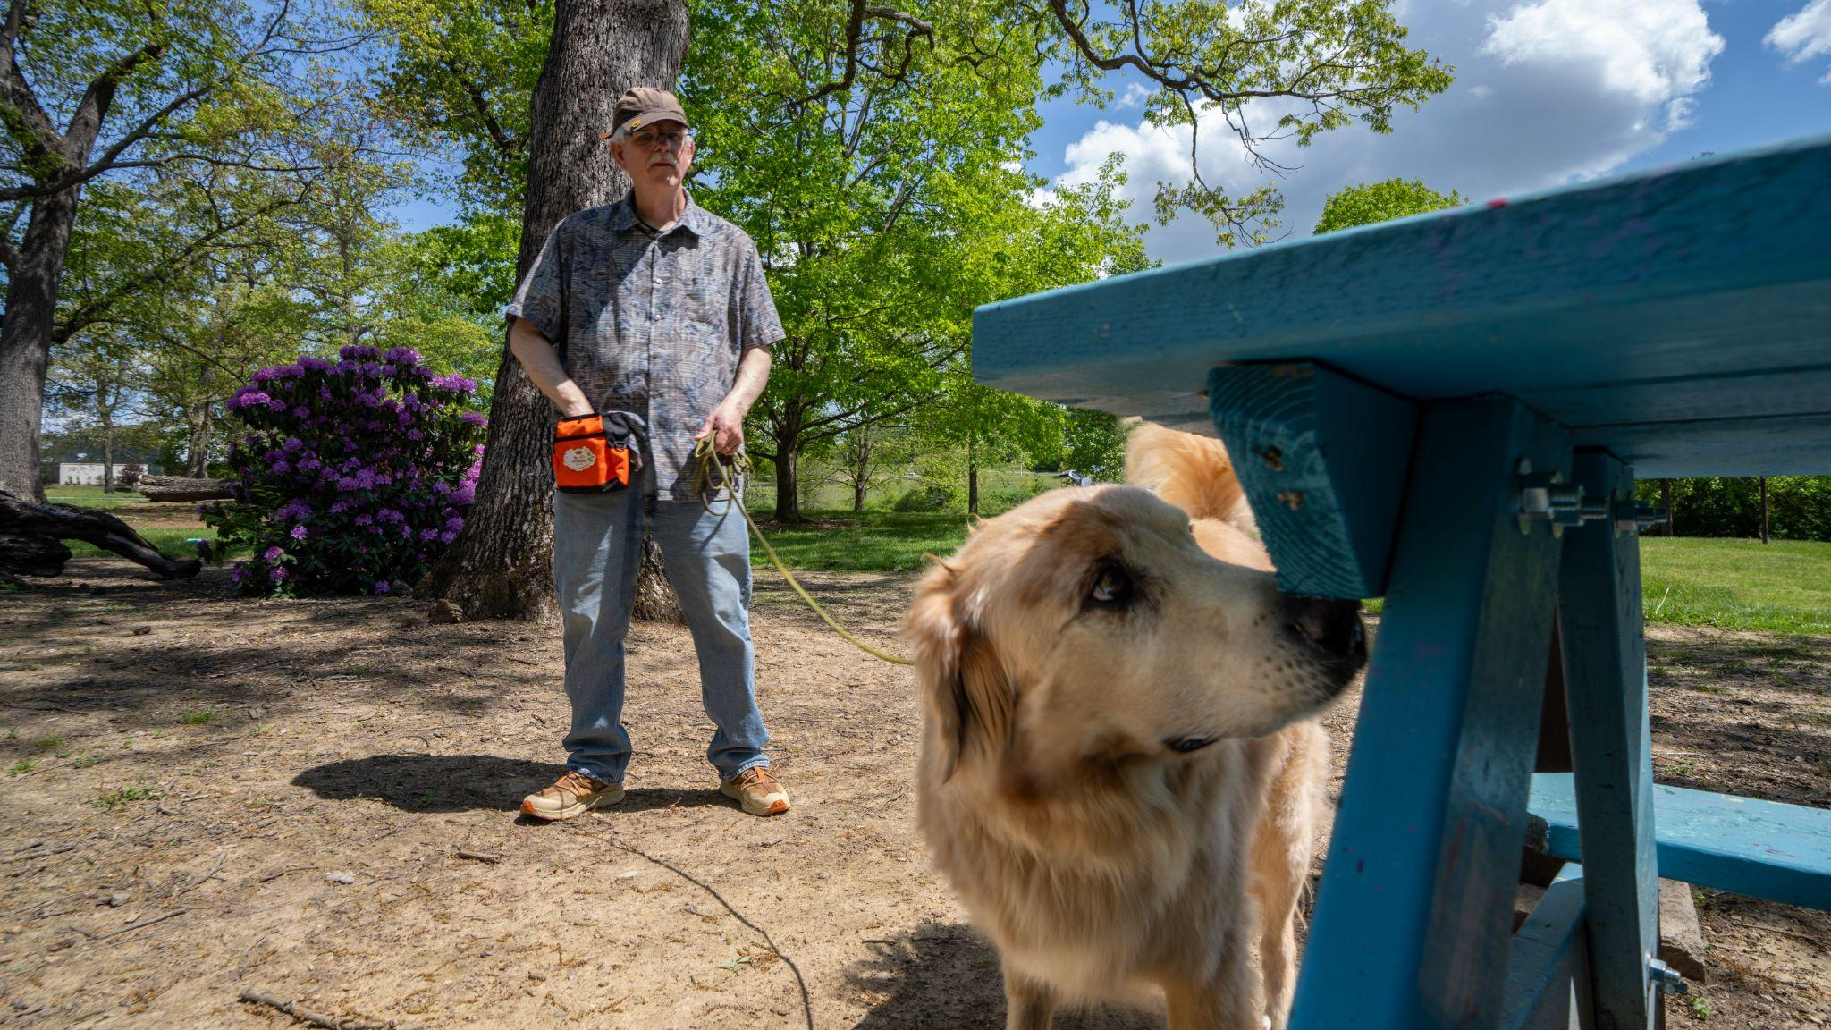
Man’s best friend could be the spotted lanternfly’s worst enemy
Notes:
Imagine if your dog’s favorite game — sniffing out treats or toys — could help protect America’s vineyards, orchards, and forests from a devastating invader. It turns out, it just might.

Slide 10
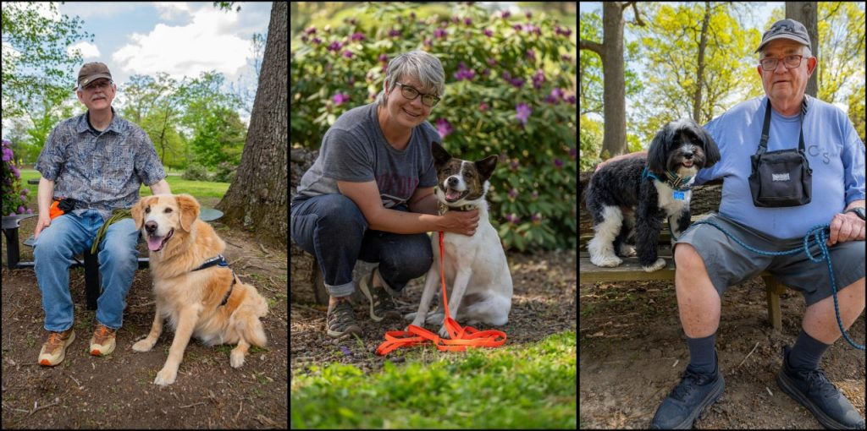
Quote Callout
MEDIA MATTERS
Research Summary
The study found that volunteer dog-owner teams can successfully detect spotted lanternfly egg masses, which in turn could help protect U.S. vineyards, orchards, and forests from this invasive pest.
It’s the first study to show that citizen dog-handler teams can achieve detection success rates similar to professional conservation detection dogs.

Slide 11
Quote Callout
MEDIA MATTERS
Timeline
March 26 - Media request from Washington Post on research topic
March 31 - Flagged new research for CALS communications team
April - June - CALS comms team communicated with researchers and media relations on publication date
June 4 - CALS comms team contacted PeerJ to get an exact date
June 25 - Publication date set for July 16
July 9 - Pitching began under embargo / Journal shared advanced copy
July 16 - Embargo lifted

Slide 12
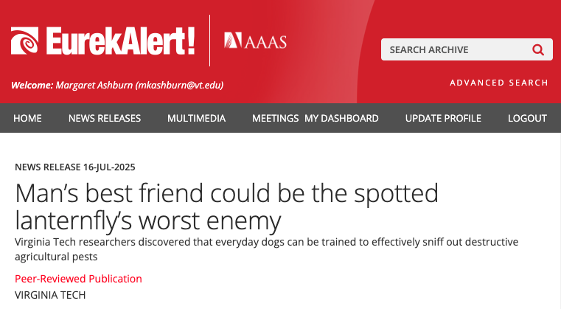
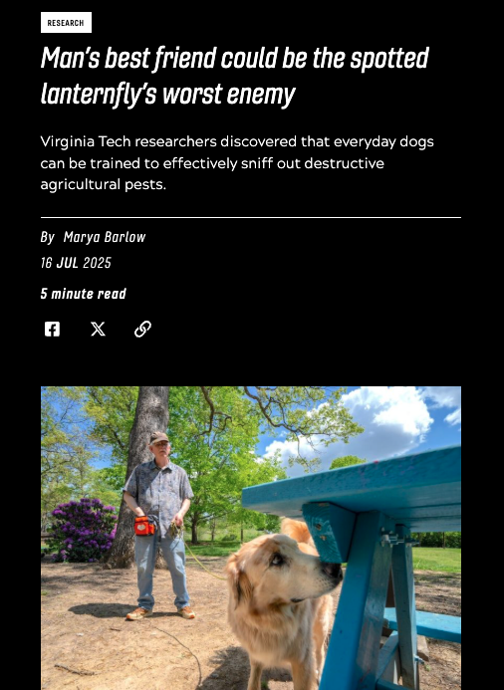
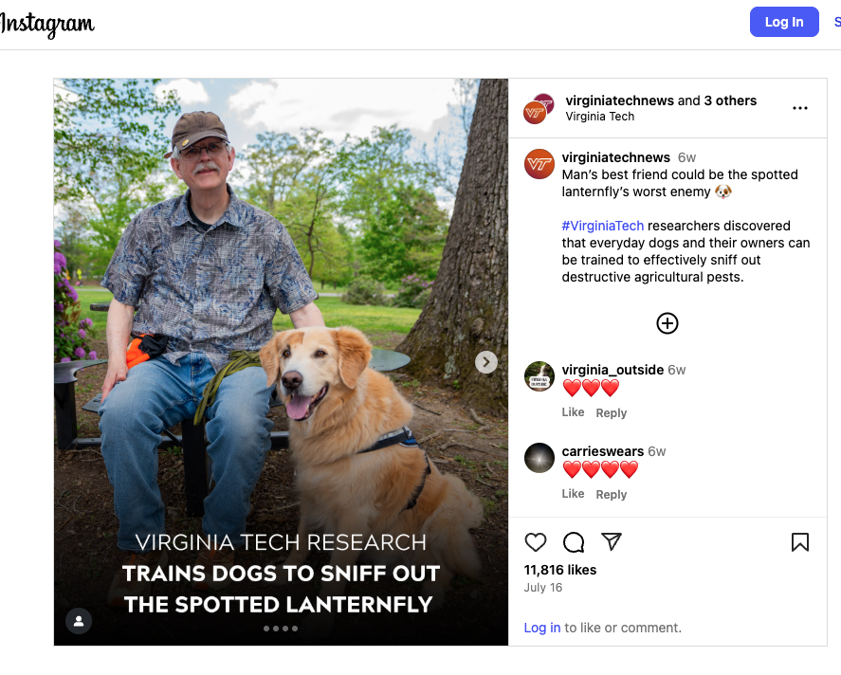
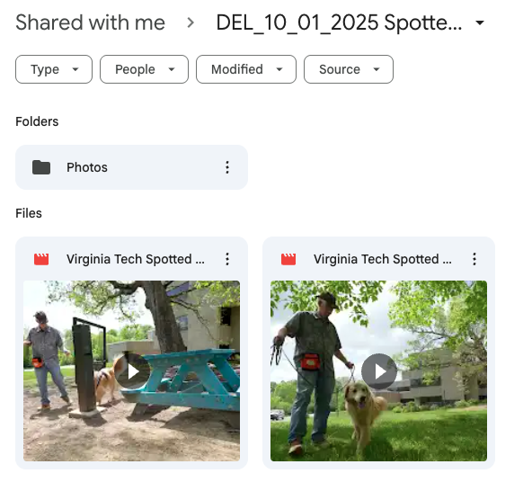
Quote Callout
MEDIA MATTERS
Media Assets

Slide 13
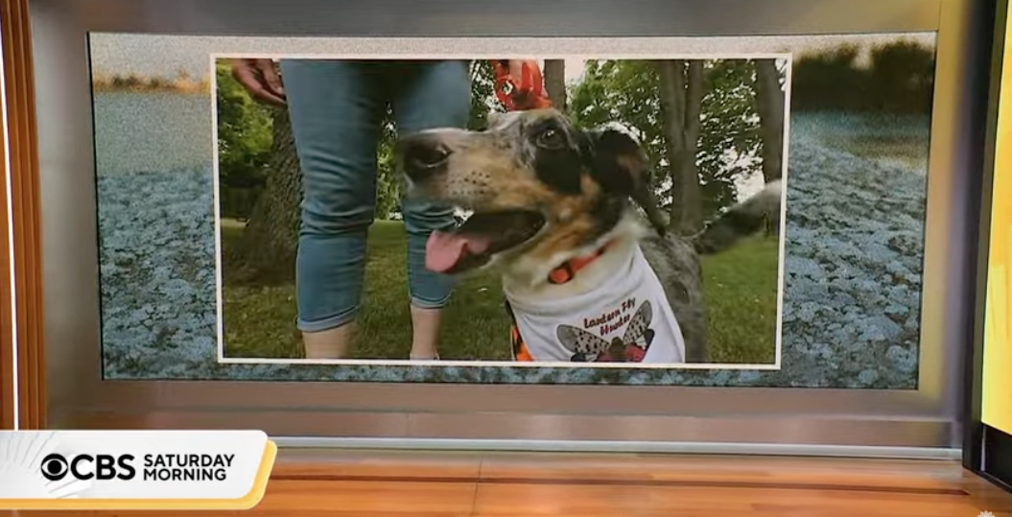
Quote Callout
MEDIA MATTERS
Media Coverage
Washington Post
PBS NewsHour
The Guardian
Fast Company
Northern Virginia Magazine
WDBJ
WSLS
WSET
Roanoke Times
And more…

Slide 14
Quote Callout
MEDIA MATTERS
A conversation with our guests
Jadrian Wooten
Collegiate Associate Professor, Department of Economics
College of Science
Erica Feuerbacher
Associate Professor, School of Animal Sciences
College of Agriculture and Life Sciences

Slide 15
Quote Callout
MEDIA MATTERS
Takeaways
Relationships matter
Collaboration builds clarity
Media amplifies impact
Communicators help faculty find their public voice

Slide 16

Quote Callout
MEDIA MATTERS
Questions?
Media Relations Contact:
mediarelations@vt.edu

