Slide 1


HOKIE BRAND CAMP
Morning Session
Notes:
m

Slide 2
MARKETING AND COMMUNICATIONS
Welcome!
Tom Wamsley
Senior Vice President
Advancement
Virginia Tech

Slide 3
MARKETING AND COMMUNICATIONS
Special Guest Speaker
Jadrian Wooten, PhD
Collegiate Associate Professor of Economics
and Director of Undergraduate Studies
College of Science
Virginia Tech

Slide 4
MARKETING AND COMMUNICATIONS
Council
Marketing and Communications Executive Team
College and Unit MarComm Leads

Slide 5
MARKETING AND COMMUNICATIONS COUNCIL
EXECUTIVE TEAM
Shannon Andrea
DC Area
Zeke Barlow
Colleges
and Units
Heather Ducote
Marketing and
Brand Management
Roger Duvall
WVTF and
Radio IQ
Annie McCallum Advancement Communications
Heather Miano
Chief of Staff
Mark Owczarski
Interim VP / AVP
University Spokesperson
Brad Soucy
Innovation and
Partnerships
Michael Stowe
News and Information
Jesse Tuel
Colleges
and Units

Slide 6
MARKETING AND COMMUNICATIONS COUNCIL
COLLEGE AND UNIT LEADERSHIP
Jenny Boone Liberal Arts and Human Sciences
Greg Carter Enrollment Management
Brian Cox
Athletics
Max Esterhuizen
Natural Resources and Environment
Cathy Grimes Graduate School
Ann Brown University
Libraries
Katie Gehrt
Center for
the Arts
Dave Guerin
Office of the Provost
Lindsey Haugh Research and Innovation
Marc Kaplan Business
Andy Mann Veterinary Medicine
Rich Mathieson Outreach and International
Affairs
Josh Meyer
Medicine
Stephanie Overton University Operations
John Pastor Health Sciences and Technology / FBRI at VTC
Ashley Roberts Student Affairs
Chelsea Seeber
Engineering
Tom Soladay Agriculture and Life Sciences
Kris Timney Architecture, Arts, and Design
Lon Wagner Science

Slide 7
MARKETING AND COMMUNICATIONS
Audience Segmentation
Current
Revised

Slide 8
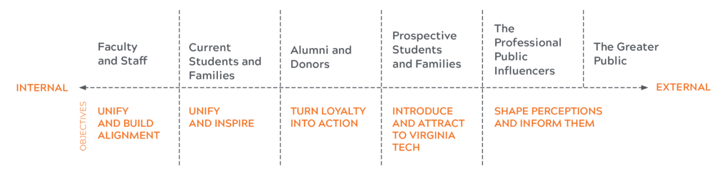
AUDIENCE SEGMENTATION - CURRENT

Slide 9
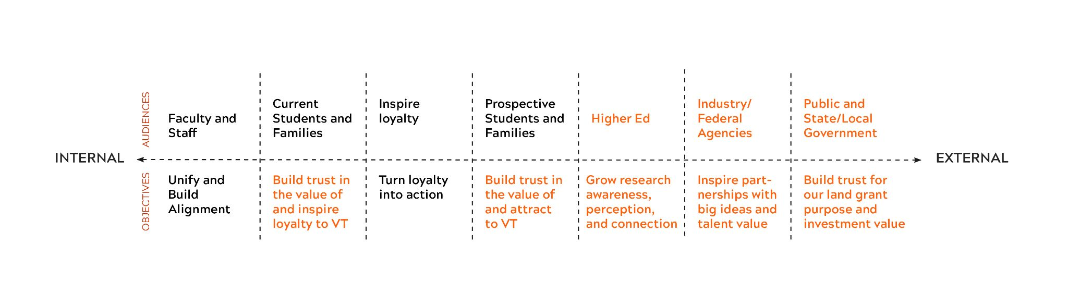

AUDIENCE SEGMENTATION - REVISED

Slide 10

QUESTIONS?

Slide 11
MARKETING AND COMMUNICATIONS
Big Wins
By the Numbers

Slide 12
MARKETING AND COMMUNICATIONS
Big Wins
12.4 million
social impressions for Metallica

Slide 13
MARKETING AND COMMUNICATIONS
Big Wins
16.6 million
research marketing impressions
60+
countries

Slide 14
MARKETING AND COMMUNICATIONS
Big Wins
5,304
top tier media hits

Slide 15
MARKETING AND COMMUNICATIONS
Big Wins
$53.4 million
raised for Virginia Tech Advantage

Slide 16
MARKETING AND COMMUNICATIONS
Big Wins
300,000
square feet in our new Alexandria building

Slide 17
MARKETING AND COMMUNICATIONS
Big Wins
24,106
Hokies who stepped up on Giving Day

Slide 18
MARKETING AND COMMUNICATIONS
New for FY26
Brand Center access
Digital agency of record
New in the D.C. area
Mentoring program for all MarComms

Slide 19
VENDOR FAIR is now open!

