Slide 1


HOKIE BRAND CAMP
Research Matters, and
So Does Research Storytelling
Travis Williams, Assistant Director of Marketing and Communications, Research and Innovation
Shay Barnhart, Director of Virginia Tech News
Lindsey Haugh, Senior Director of Marketing and Communications, Research and Innovation

Slide 2
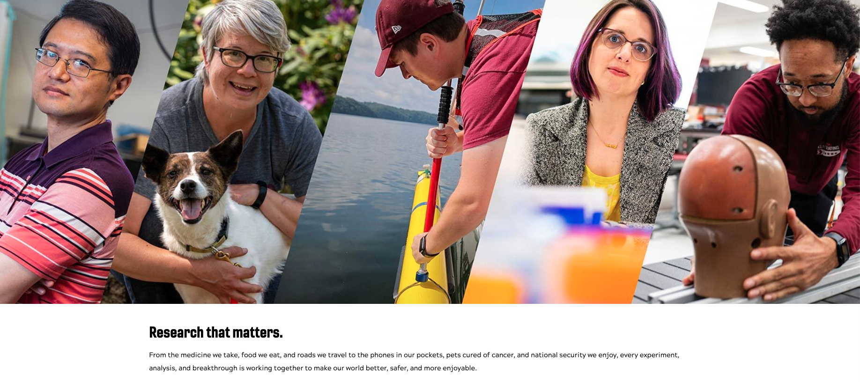
RESEARCH STORYTELLING

Slide 3


RESEARCH STORYTELLING
SESSION OVERVIEW
Three Rs
Ledes
Nut graphs
Voices
Best story
Activity

Slide 4
RESEARCH STORYTELLING
THREE GOALS for a research story are for it to be:
Read
Remembered
Repeated

Slide 5
RESEARCH STORYTELLING
Ledes or leads
“
The journalism lead’s main job (I’m personally fond of the nostalgic spelling, “lede,” that derives from the bygone days of typesetting when newspaper folks needed to differentiate the lead of a story from the lead of hot type) is to make the reader want to stay and spend some precious time with whatever you’ve written. It sets the tone and pace and direction for everything that follows. It is the puzzle piece on which the rest of the story depends. To that end, please write your lead first — don’t undermine it by going back and thinking of one to slap on after you’ve finished writing the rest of the story.
– NPR’s HANNAH BLOCH
“
Turn browsers into readers by engaging them until at least the nut graph.
- TRAVIS WILLIAMS
”
”

Slide 6
RESEARCH STORYTELLING
Lede dealbreakers
Burying the lede by starting with context and/or telling the reader why the topic is important (throat clearing)
Attempting to summarize all of the 5Ws of the story
A quote
An abundance of titles, college/unit names, parenthesis, and/or acronyms (more than one comma is usually a red flag)

Slide 7
RESEARCH STORYTELLING
Nut graphs
“
The nut graf tells the reader what the writer is up to; it delivers a promise of the story’s content and message. It’s called the nut graf because, like a nut, it contains the ‘kernel,’ or essential theme, of the story. At The Philadelphia Inquirer, reporters and editors called it the ‘You may have wondered why we invited you to this party?’ section.
– Chip Scanlan, Poynter
“
I was taught that nut grafs should answer the question: This is important because? In fact, in the beginning, we had to write out nut grafs with the phrasing: This is important because…
– SHAY BARNHART
”
”

Slide 8
RESEARCH STORYTELLING
Nut graph types/attributes
Compelling – why should you care?
Transitional
Directional
Timeliness
One paragraph, early entry
Concise
Followed by supporting details

Slide 9
RESEARCH STORYTELLING
Nut graph example 1
Blacksburg, Va. — High on a mountain overlook, construction crews blast through solid rock on a 20-hours-a-day rush schedule to build the first two miles of an expressway that, for the next few years, will lead only to a turn-around.
But for promoters in this Appalachian university town, that’s of little concern. Dubbed the “Smart Road” and designed to double as a high-technology research site, this federal-state project shows how a little “pork” tucked into a federal transportation bill can buy a whole hog for a community.
-- Julia Malone, Atlanta Journal Constitution

Slide 10
RESEARCH STORYTELLING
Nut graph example 2
The nation has a third weapon to wield against the coronavirus, and this one doesn’t need to be kept frozen or followed by a booster shot.
Those attributes of Johnson & Johnson’s coronavirus vaccine, which gained regulatory clearance on Saturday, promise to help state and local officials quell the pandemic. First, however, they will need to determine its place in an expanding anti-virus arsenal, where it joins vaccines with sky-high efficacy rates that are still in short supply.
Decisions to send the shots to harder-to-reach communities make practical sense, because Johnson & Johnson’s single-shot vaccine is easier to store and use. But they could drive perceptions of a two-tiered vaccine system, riven along racial or class lines — with marginalized communities getting what they think is an inferior product.
—”Johnson & Johnson vaccine deepens concerns over racial and geographic inequities,”
The Washington Post, March 1, 2021

Slide 11
RESEARCH STORYTELLING
Non-Virginia Tech Voices
Place narrative within context
Partners: Industry, government, higher ed peer
Media coverage
Public comments
Mentor, boss

Slide 12
RESEARCH STORYTELLING
Best story, general tips
Find the best story
Ask -- so what?
What do the sources want the reader to know most?
Researcher motivation
Someone impacted by the work
Reporting is never done
Story is a service to the reader

Slide 13
RESEARCH STORYTELLING
Please don’t….
Bury the news
Include unattributed information
Use one voice
Use over complicated words
Use acronyms or jargon

Slide 14
RESEARCH STORYTELLING
Activity
You’ve been tasked with writing a story on the published paper below that helps a general audience understand the value of this work on an individual, community, and national level.
Work with friends around you.
Part 1: Write out why the story is important.
Part 2: Identify what voices you need and draft a handful of quotes that will help bring the story to life for the reader. You can use existing quotes or quotes you imagine you might get from further reporting. For the latter, you should consider what angle from which you’d want a person to speak on the topic and draft a couple potential questions.

Slide 15
RESEARCH STORYTELLING
Activity Part 1

Slide 16
RESEARCH STORYTELLING
Activity Part 2

